Slide 1
ECSE 211
Design Principles and Methods
TEAM 2 - WEEK 5

Slide 2
DEMO RECAP
What happened?
The robot was able to connect to the server
It crashed into the wall
The firing pin failed to trigger
What worked?
Wifi connection to the server works
What didn’t work?
Localization took too long and failed
The ball launcher code didn’t manage to fire the crossbow
What have we improved since?
pathfinder now works
localizaler works and is quick
pilot is working
odometery correction is present
What have we learned from this?
We should have tested more robustly
the weight distribution was off and caused sliding

Slide 3
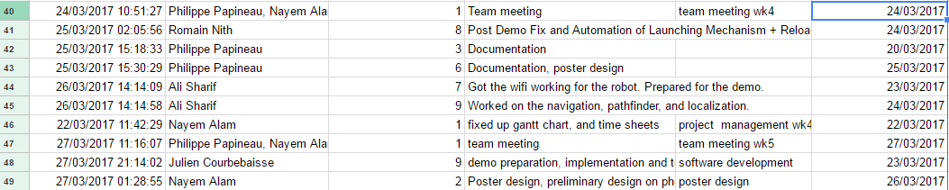
BUDGET - WEEK 4-5

Slide 4
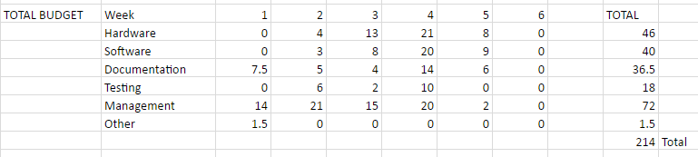
Week 4 - Overtime
Going overtime for the week because we ended up working on most of the code and fixing everything during demo week to make sure everything works. This is a concern because there is still more to be done such as tweaking the code, writing more test reports, documents, etc.

Slide 5
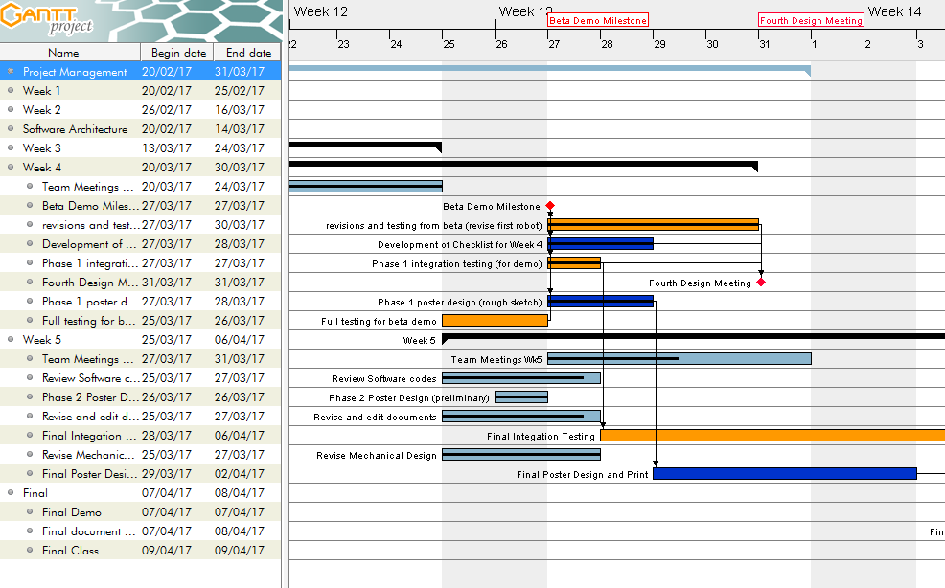
Progress as of March 23, 2017

Slide 6
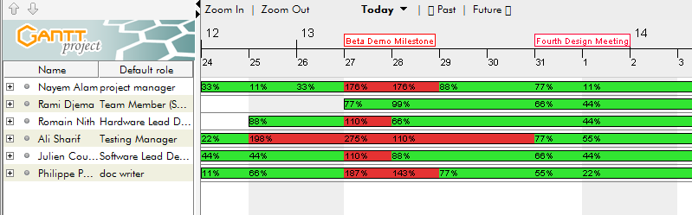
Resources as of March 17, 2017

Slide 7
Updates on documents
No changes but very minor updates in the System’s Document
Minor update on Constraint Document’s Hardware section
Philippe: Give brief summary of the current state of the Hardware, Software and Testing Documents.

Slide 8
Updates: Mechanical Design

Slide 9
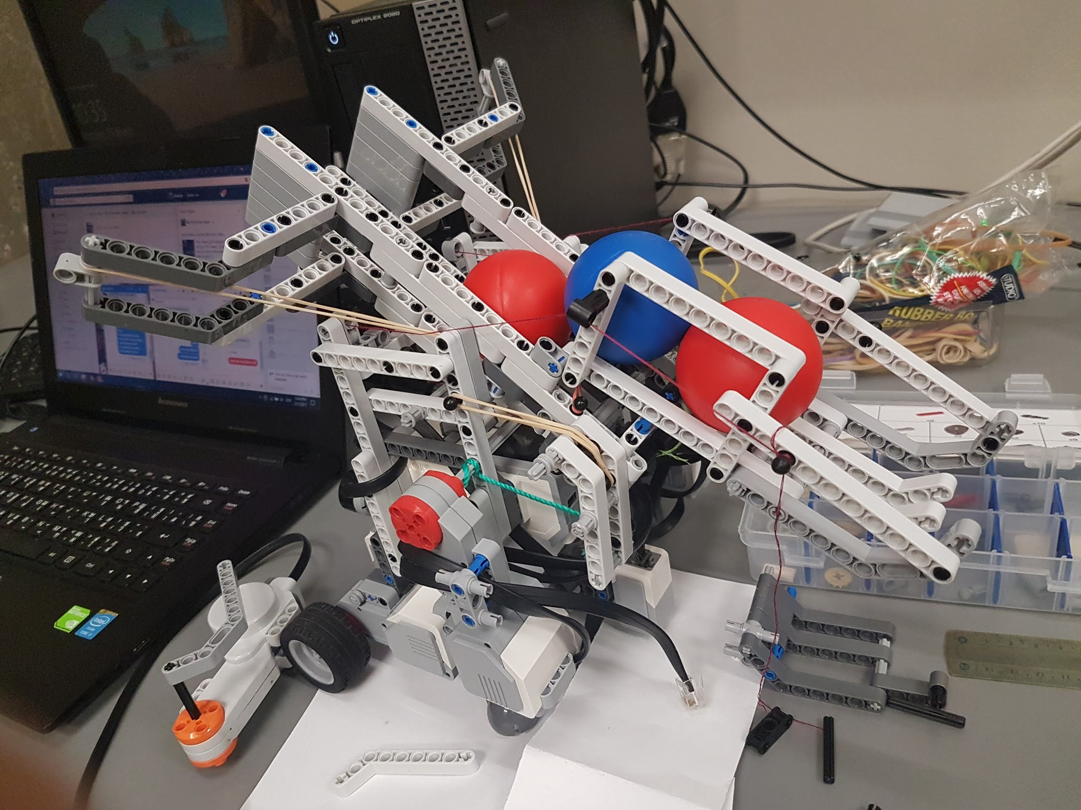
Mechanical Design
At the demo, launching mechanism failed to work. This was due to the overall structure being loose and different rubber bands being used
Post demo:
Implementation of reload mechanism and ball retrieval
Tune launcher to hit target at 7 tiles while hitting the floor
Needs a more solid defense mechanism

Slide 10
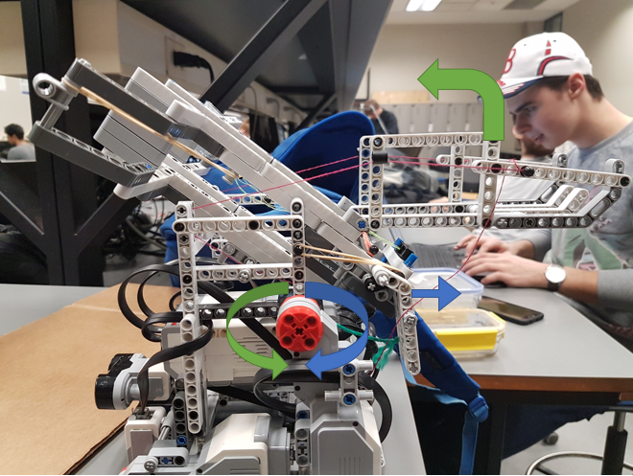
Trigger Mechanism

Slide 11
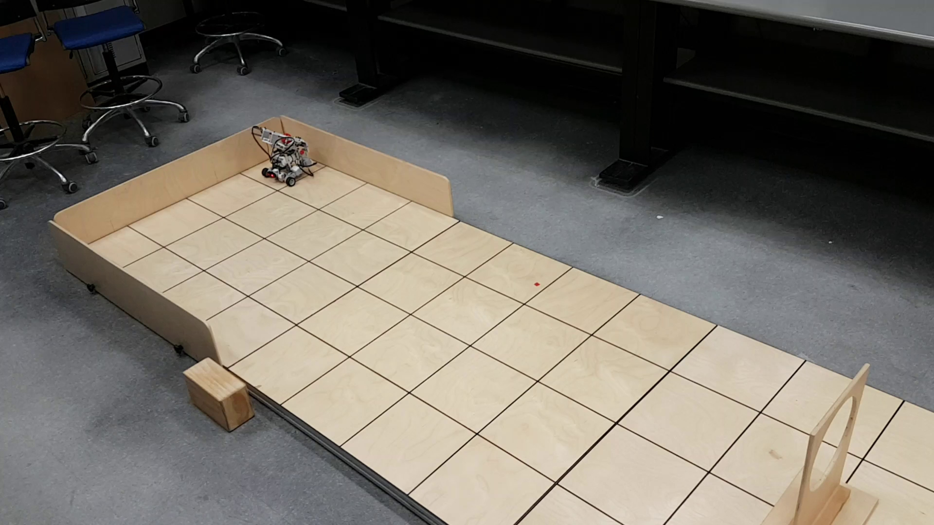
Robot Navigating & Launch Ball Video (After Demo)

Slide 12
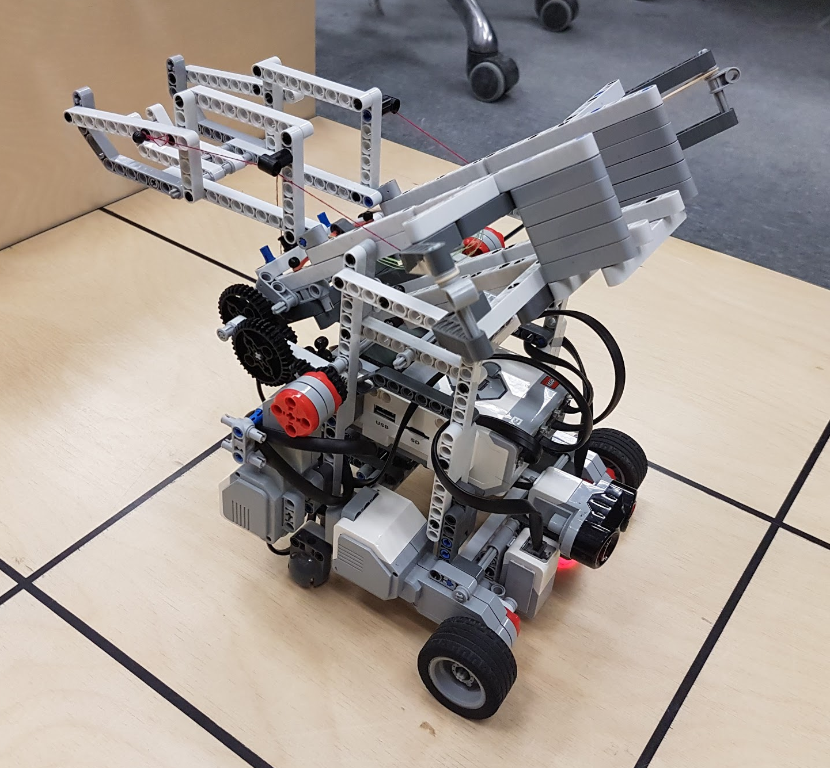
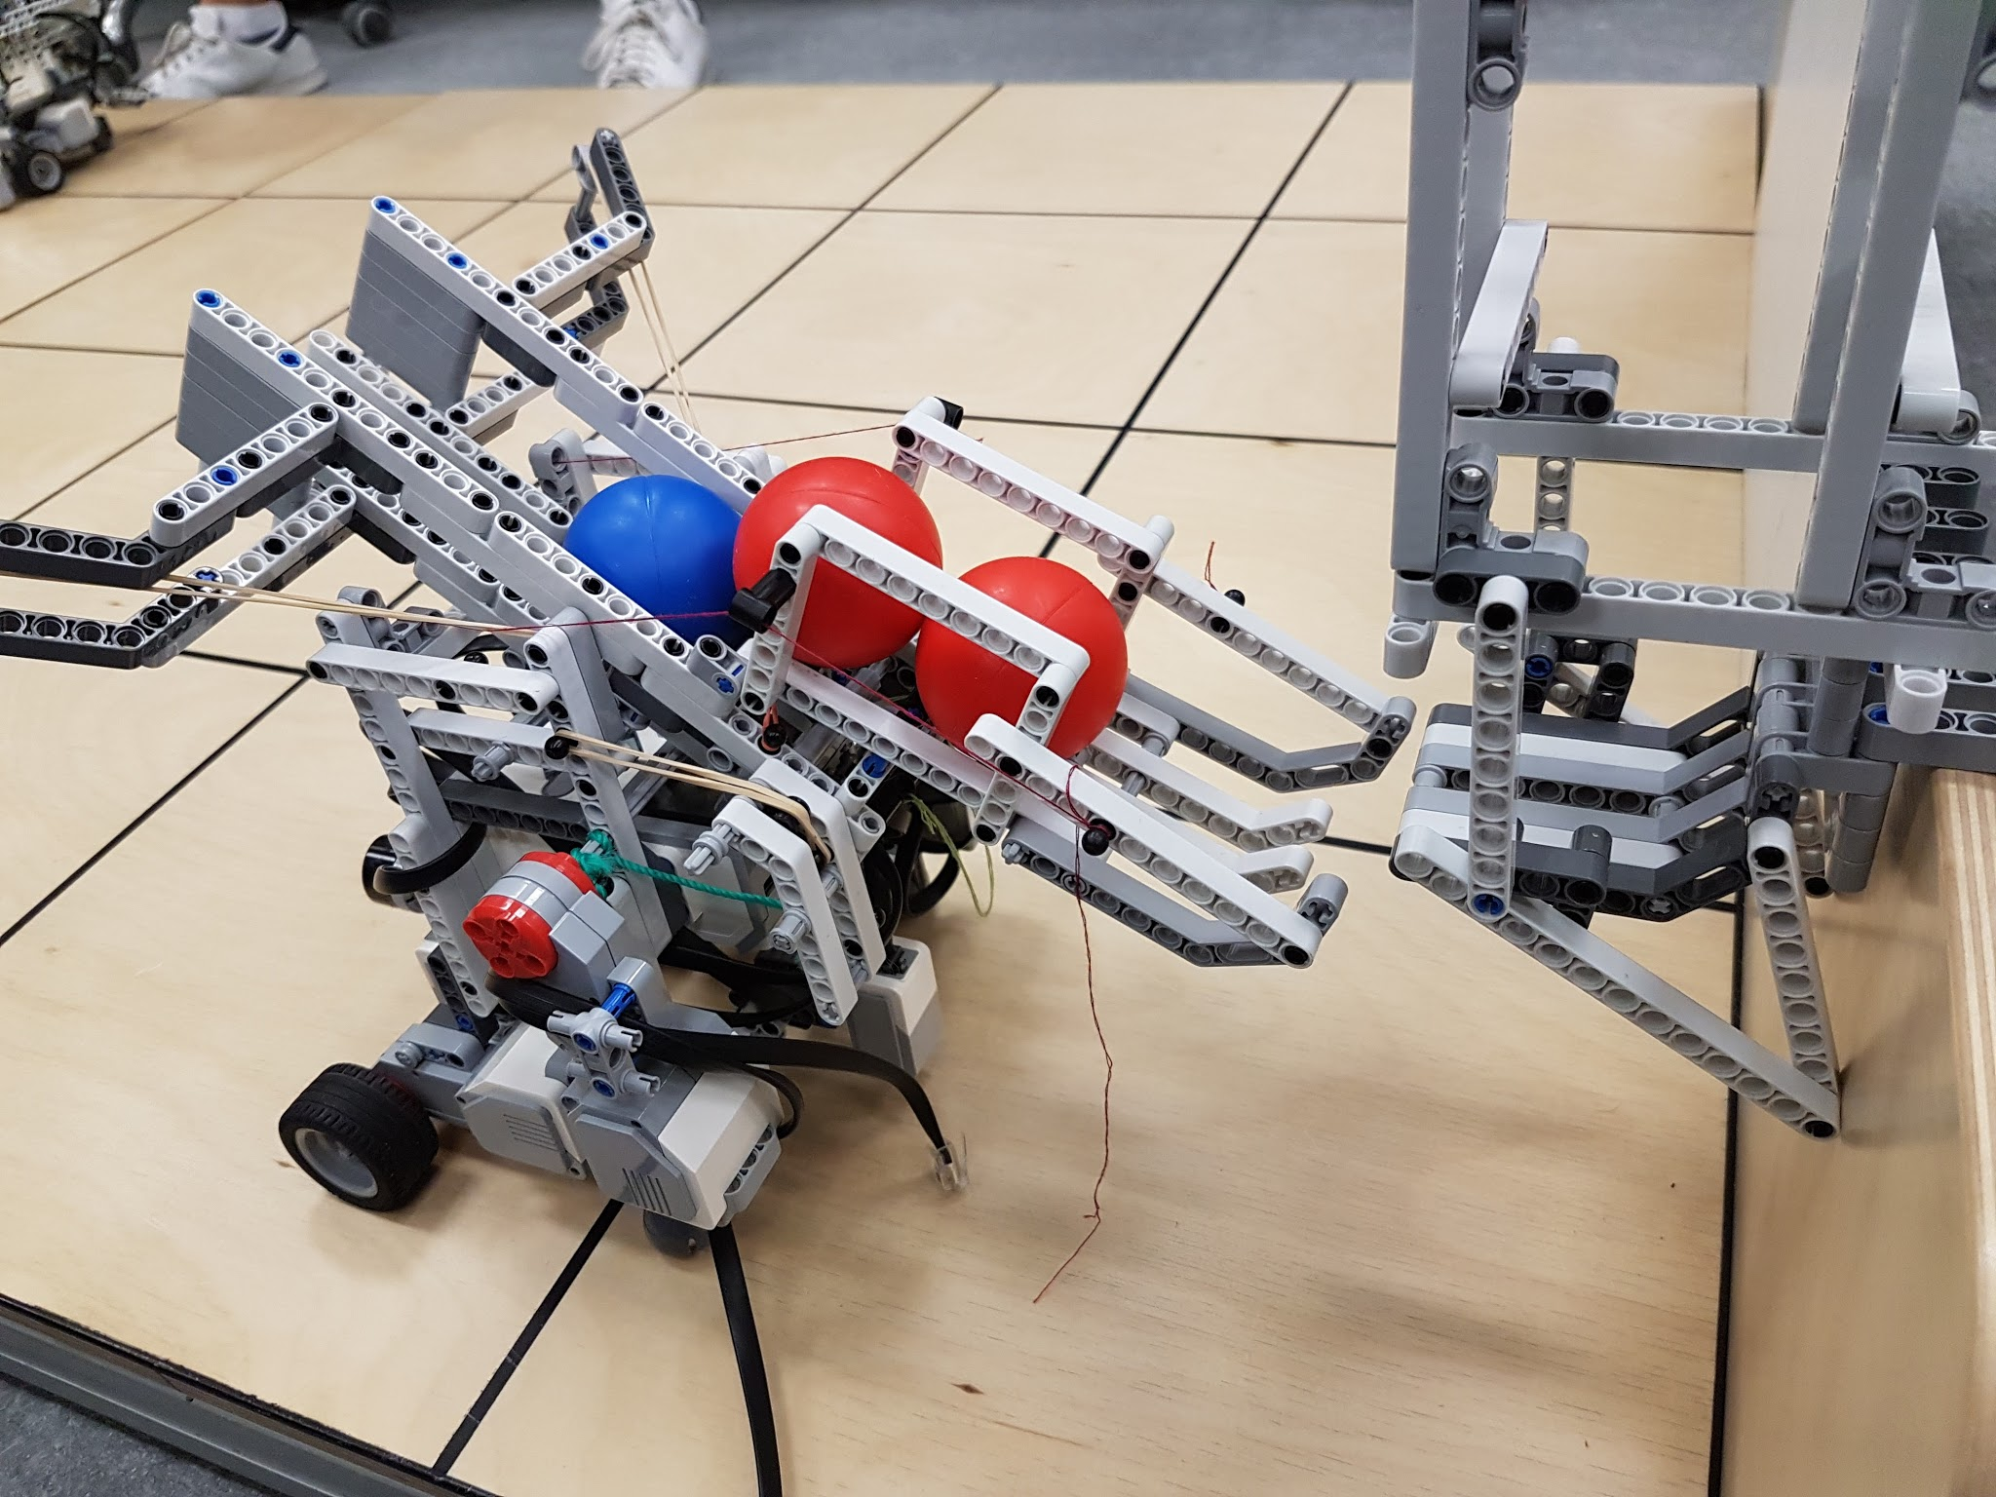
Final Robot
Minor tweaking needed

Slide 13
Software Update

Slide 14
Copy of our complete source code
Complete Source Code of everything we have so far is on Dropbox under “Software”

Slide 15
Testing
Not using light sensor for localization because of errors
Ultrasonic sensor works properly
Navigation code - 2 implementations (continuous reading and one shot)
Odometer code modified and implemented - done (ready for demo)
Testing documents have been updated
DEMO failed - corrected Localization, Navigation, and Shooting(still needs a little fixing for consistency)
Roughly 1900 lines of code written so far

Slide 16
Navigation Testing
2 tests
1st test: strong bouncing effect – implemented new pilot -fixed
2nd test: one shot, medium degree of error
Don’t know which one to pick yet because odometry correction hasn’t been implemented yet (should be done by thursday night) - will be updated on dropbox

Slide 17
Localization Testing
Takes roughly 48 seconds to localize (should be under 30 sec by friday)
Errors - Ultrasonic sensor has < 3 degrees (90% of time)
We’ll implement position calculation using ultrasonic sensor instead of the light sensor
US localization spreadsheet result uploaded testing code is documented but not fully complete and submitted on dropbox.

Slide 18
Ball Launcher Testing
Covers approximately 9 tiles
Works so far within 2 motors
Based on elastics (elastic crossbow - reloading is done manually)
No inconvenience for the robot’s structure, robot doesn’t tilt or anything when it shoots
Mechanical design is done for the demo

Slide 19
Summary for progress so far regarding project
All documents updated
Hardware, testing, software document is now properly updated
After demo fail, tested robot for localization, navigation and ball throwing (it works now properly) - put test video after this slide
Robot is not ready yet because we need to implement odometry corrector
Gantt chart updated with completion bars + hours according to this week
An improvement of Mark III design - now on dropbox
Wifi code implemented and completed
Source Code – complete copy of source code is up on dropbox

Slide 20
Summary of Issues resolved so far by testing and modification
Summary of Issues yet to be resolved
Structural solidity of the robot
Weight distribution: By moving the robot at high speed and with sharp turns, we solved stability issues.
We tested each launching mechanism to see how far the ball went, and modified them depending on the results.
Reloading mechanism and ball retrieval mechanism finalized
Test overall system with software
Defense mechanism

Slide 21
Plans for the following week
Finish the Odometry Correction Code by Apr 5
Continue test the robot, continue putting test results
Finish up the poster design for presentation
Record the final demo in different environments for different types of results
Fix up and finalize the four documents for the final presentation submission.
Organize all data, budget, meeting reports, agendas for submission

